Slide 1
Mobile Phone App Recognition
via Magnetic Side Channel
2021.10.13
Notes:
Mobile phone app recognition based on mobile phone magnetic side channel
This is a video introducing our latest work，MagThief, Stealing Private App Usage Data on Mobile Devices via Built-in Magnetometer.

Slide 2
Outline
Background and Motivation
Related Works and Limitations
Preliminary Analysis
System Design
Evaluation
Conclusion
Notes:
First, we will introduce the background and motivation.

Slide 3
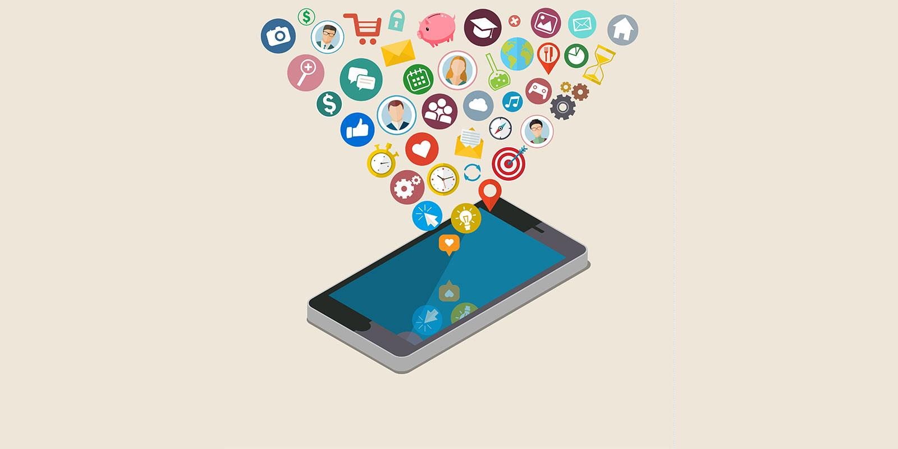


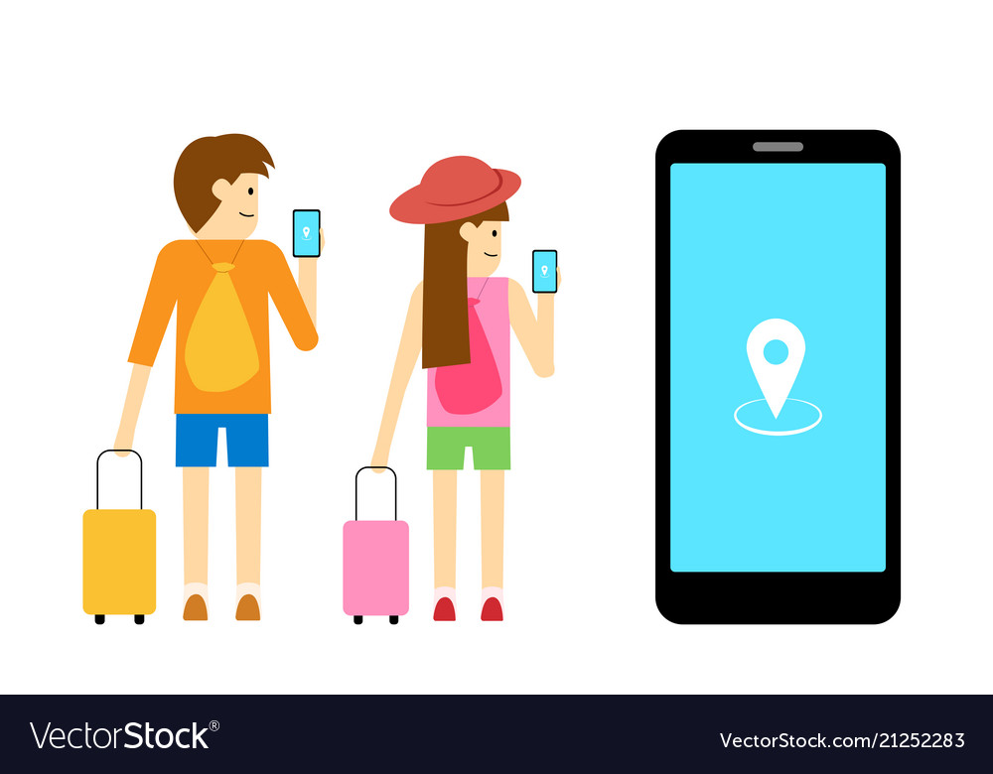

Mobile apps are so popular!
Social Network
Online Shopping
Navigation/Travel
Business/Working
Notes:
With the popularity of mobile smart devices, mobile apps are becoming more and more popular. We can use mobile apps for social networking, online shopping, traveling and navigation, working, and business, etc. Therefore, mobile apps have become an increasingly ubiquitous part of our daily life.

Slide 4
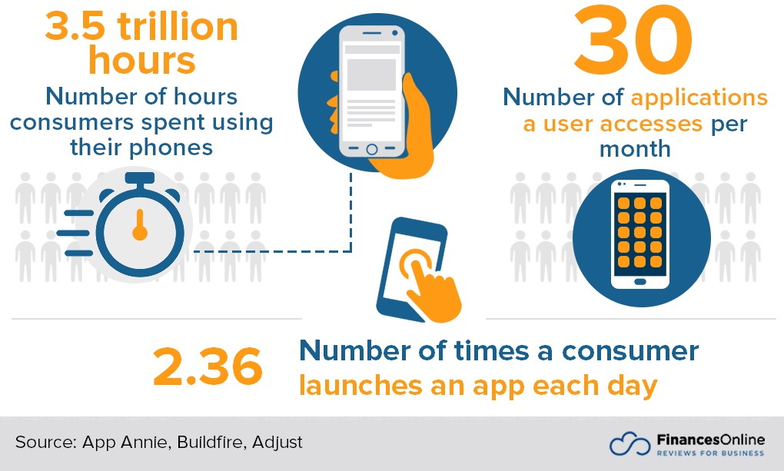
Mobile app usage by the numbers
Notes:
According to the statistics from FinancesOnline, consumers will spend a total of 3.5 trillion hours using their phones over their lifetime; they will access around 30 apps per month, and they will launch each installed app with an average of 2.36 times during a day.

Slide 5
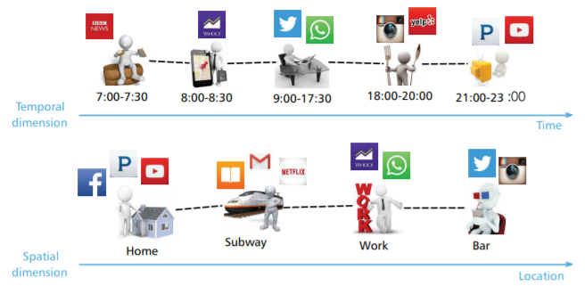
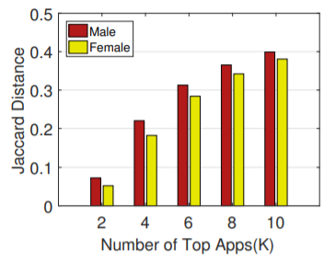
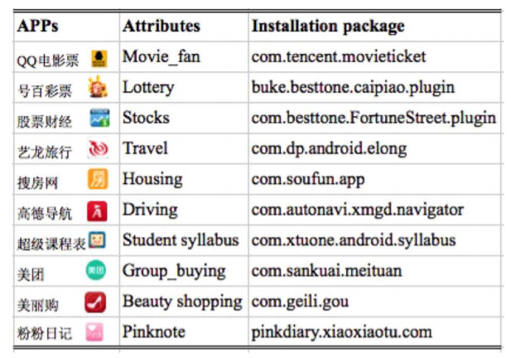
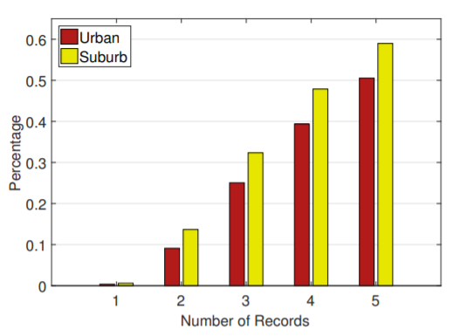
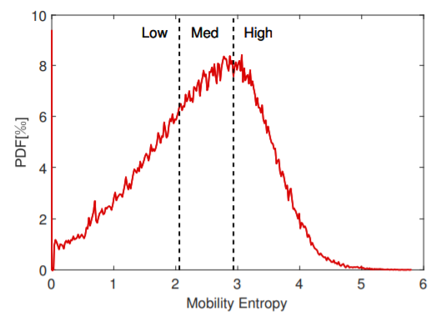
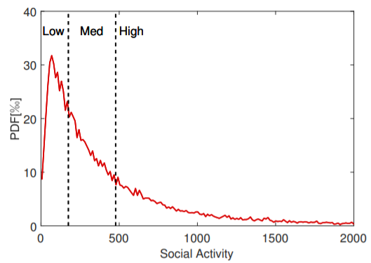
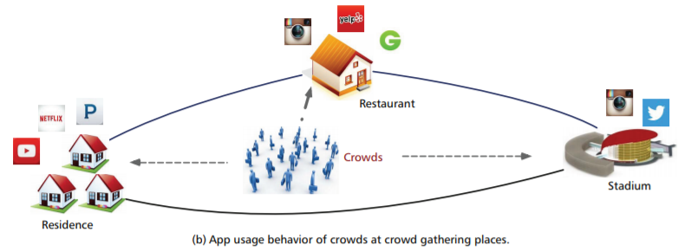
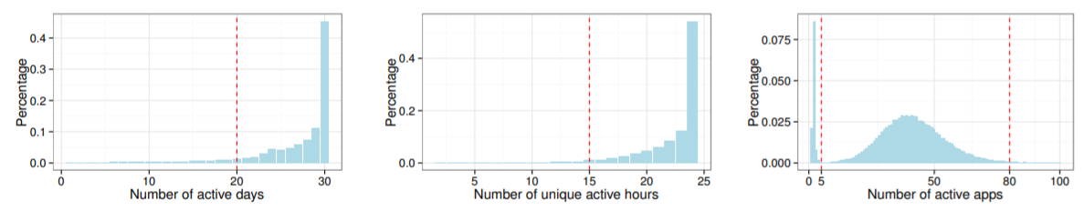
Mobile apps may also give you away…
Discover Different Types of Mobile User
Understand Human Mobility
Age, Gender, Income
Personal Interests
Spatial Info (e.g., urban or suburb)
Lifestyles (active days/hours/# of apps)
ACM UbiComp/IMWUT 2016/2018/2019
IEEE System
Journal 2017
IEEE Networks 2016
Notes:
However, when people use mobile devices, the mobile app usage information will also give the users away. There are many researchers working on Mobile Apps Usage Understanding, Modelling, and Prediction. Some works analyzed the users' app usage behaviors and discovered the concerns and sensitive information of smartphone users, like age, gender, income, personal interests, spatial information (live in urban or suburb), and lifestyles. Other works tried to understand human mobility through crowd users' app usage behaviors in terms of temporal dimension and spatial dimension.

Slide 6
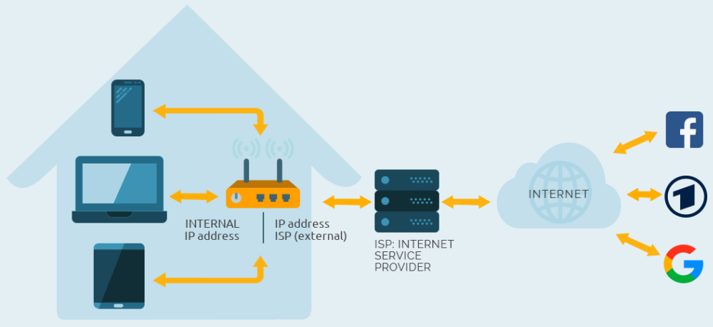
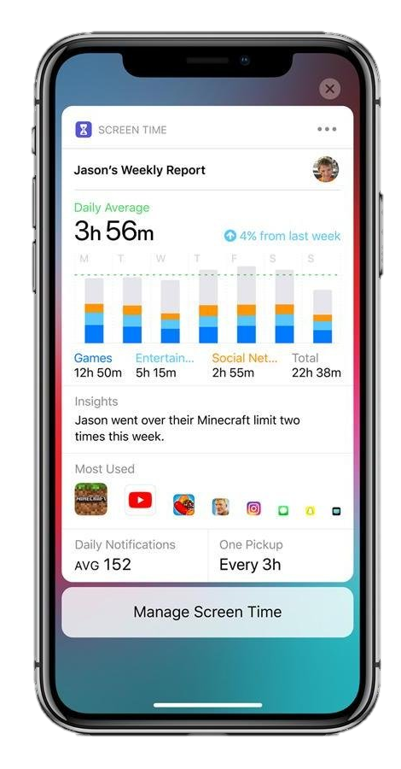
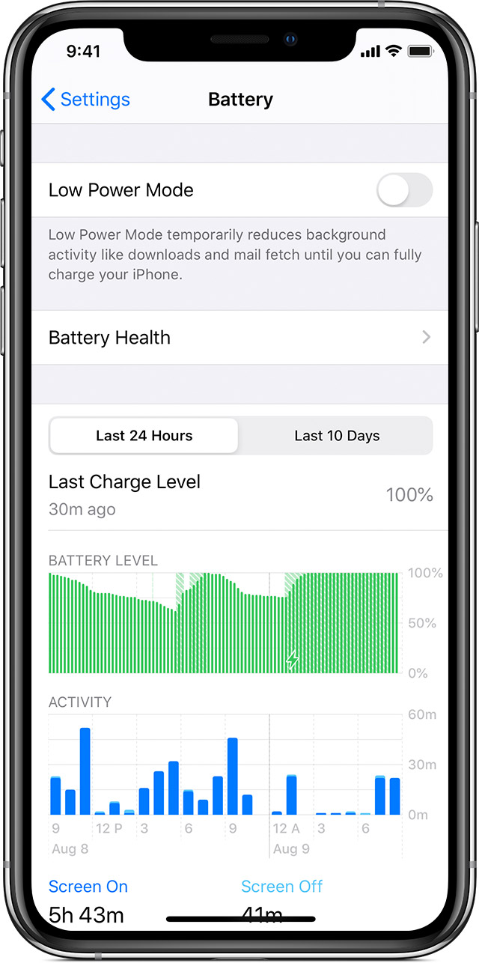
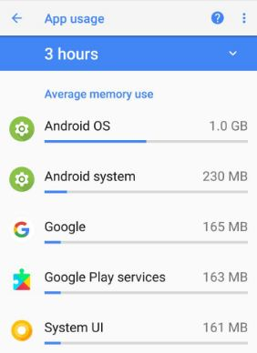

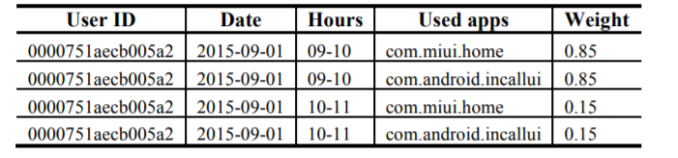
How to collect mobile app usage behaviors secretly?
Internet Service Provider (ISP) Datasets
Cellular network traffic
Extract app usage from HTTP headers
Pertain from the mobile devices directly
App usage function
System-kernel information
proc filesystem
memory
internet traffic data
battery and CPU
Privacy-related regulations limit third-party access to data ☹
Operating systems have prompted the third-party apps to curtail access to these data ☹
Notes:
Secretly collecting users' mobile app usage behavior is a difficult task. Currently, a common data source of mobile app usage information is the Internet Service Provider (ISP) datasets. They analyze the cellular network traffic data and extract the anonymous users' app usage information from HTTP headers. However, privacy-related regulations limit third-party access to the ISP datasets. Another method is to pertain the information from the mobile device directly. Many smartphone manufactures have developed the functions of app usage monitoring functions, but the attackers cannot obtain this information without user permissions. Some system-kernel information like, filesystem/memory/internet traffic, can directly obtain user's app usage information. But this type of information cannot be accessed without high-level user permissions. CPU/battery usage information is limited to the sampling rate and cannot be used to infer detailed app usage.

Slide 7
Outline
Background and Motivation
Related Works and Limitations
Preliminary Analysis
System Design
Evaluation
Conclusion
Notes:
Next, we will introduce the related works on Application launching process identification with EM side-channel signals, and describe their limitations in the practical scenarios.

Slide 8
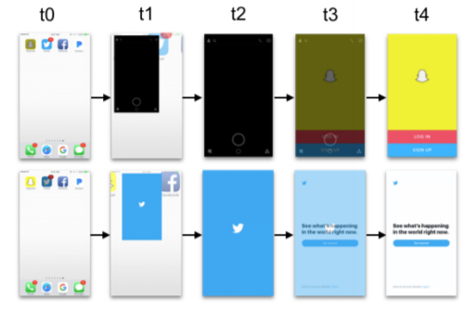
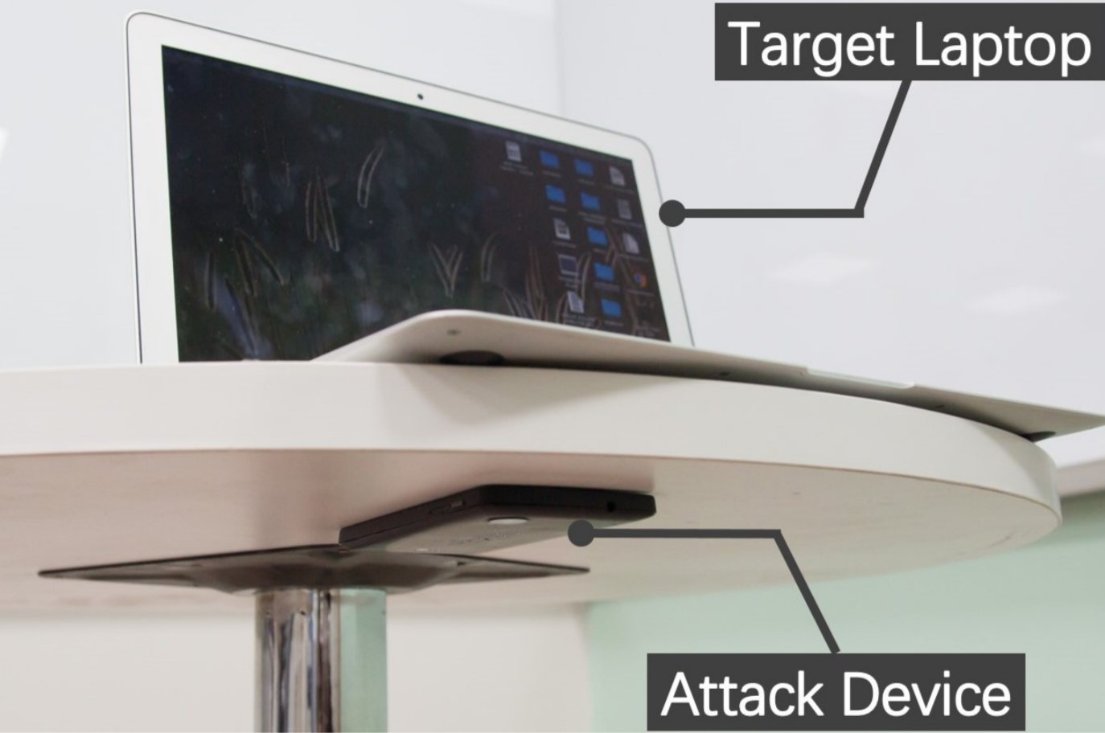
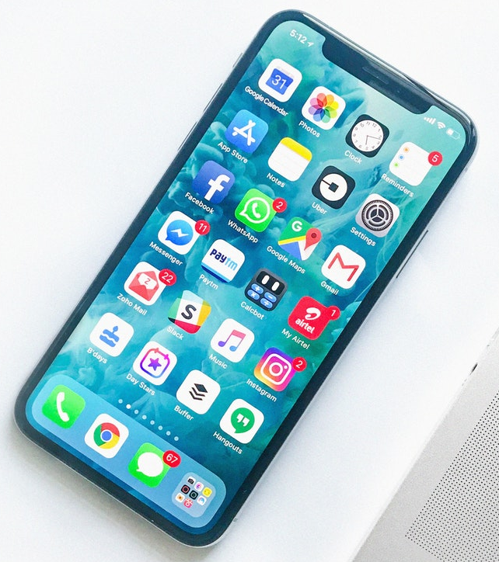
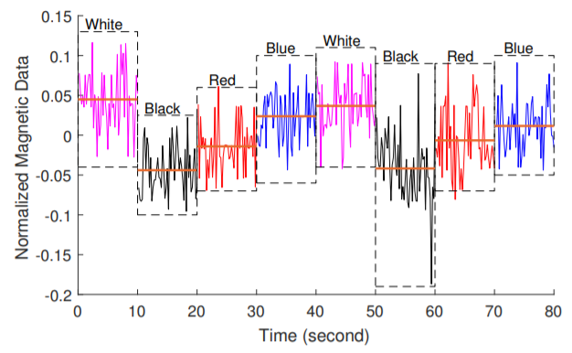
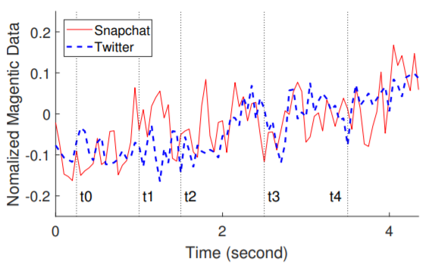
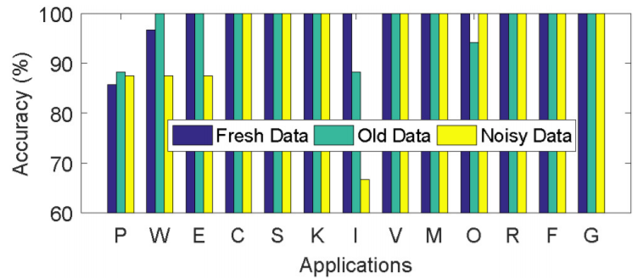
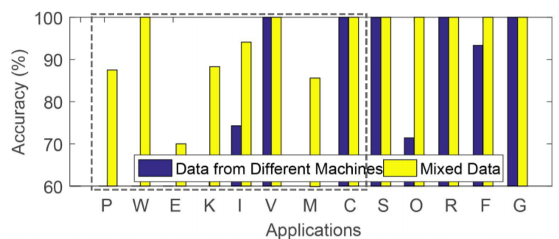
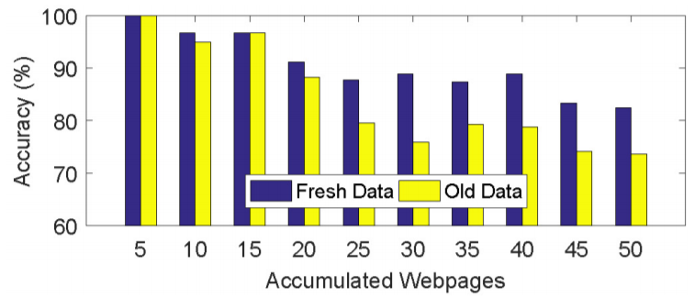
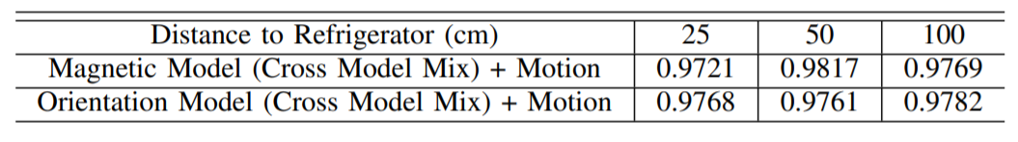
Related Work: Application launching process identification with EM side-channel signals
Use smartphone to sense victim’s
app usage on surrounding laptops
Sniff app usage on the smartphone with built-in magnetometer
Infer app usage with magnetometer readings by training CNN model
Applications classification:
Websites classification:
MagAttack (ACM AsiaCCS 2019)
Magneticspy (ACM WPES 2019)
Deepmag (IEEE PerCom 2018)
Notes:
Mag attack firstly used smartphone's magnetometer to sense victim’s launching app behaviors on surrounding laptops. And Magnetic spy used the same EM signal processing methods to analyze the built-in magnetometer readings and inferred the current smartphone's app launching information. Deepmag developed a Convolutional Neural Network model to identify the mobile app's launching process with the built-in magnetometer readings.

Slide 9
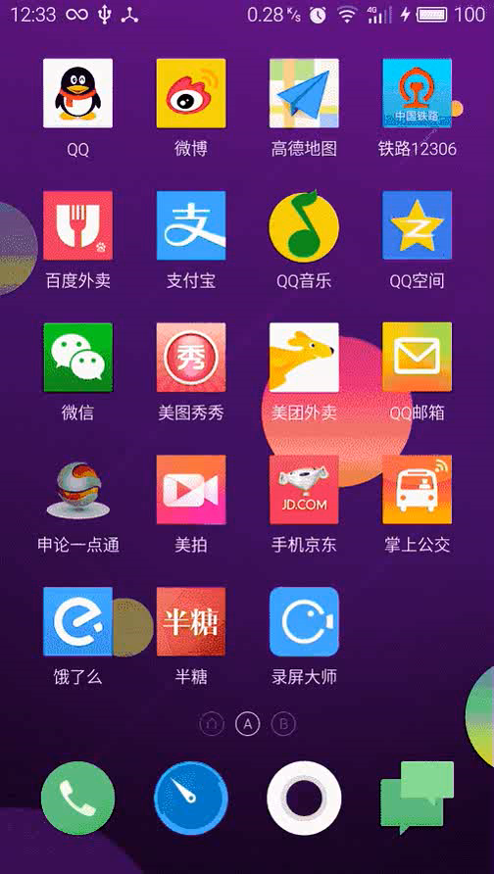
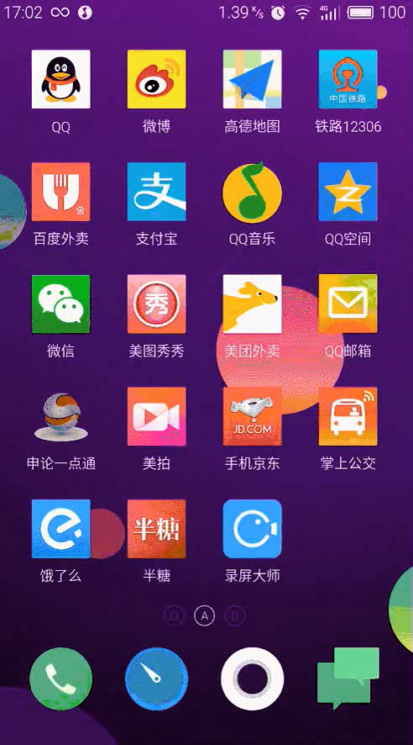
Different manners of launching an app
Cold Start (from scratch)
Warm Start (from memory)
Cold start has four tasks:
Loading and launching of the app
Displaying a theme starting window
Creating the application process
Inflating & rendering of layouts
Warm starts has one tasks:
Switching back to the app from “warming” memory.
A high-frequency method used to launch apps for the mobile users ☺
Notes:
In mobile devices, there are two main ways to launch an app. They are, cold launch and warm launch, respectively.
Cold starts occur when users open the app after they haven’t ran it for a while. And it has four tasks Loading and launching of the app, Displaying a theme starting window, Creating the application process, and Inflating & rendering of layouts.
Warm start means switching back to the app from “warming” memory. Because the app is still “warm” in memory, so warm starts are often very fast.
Warm start is also a high-frequency method used to launch apps for the mobile users.

Slide 10
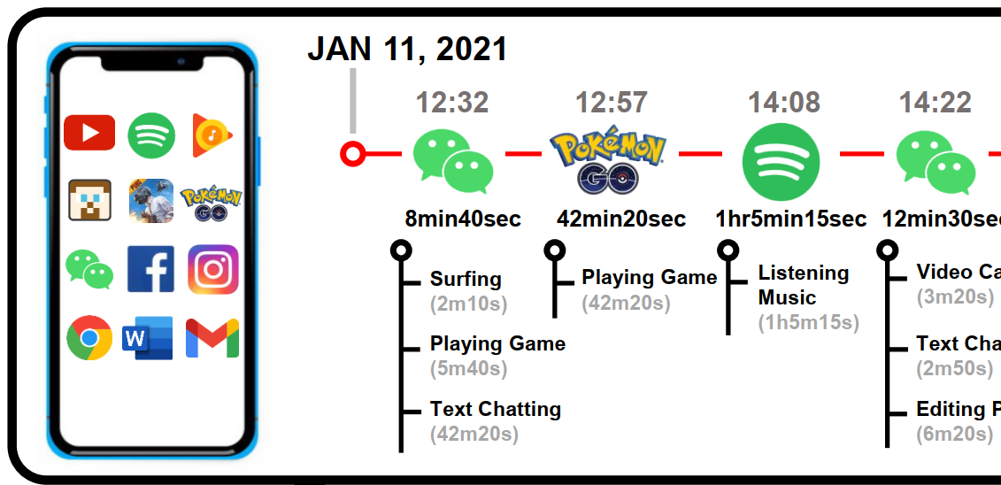
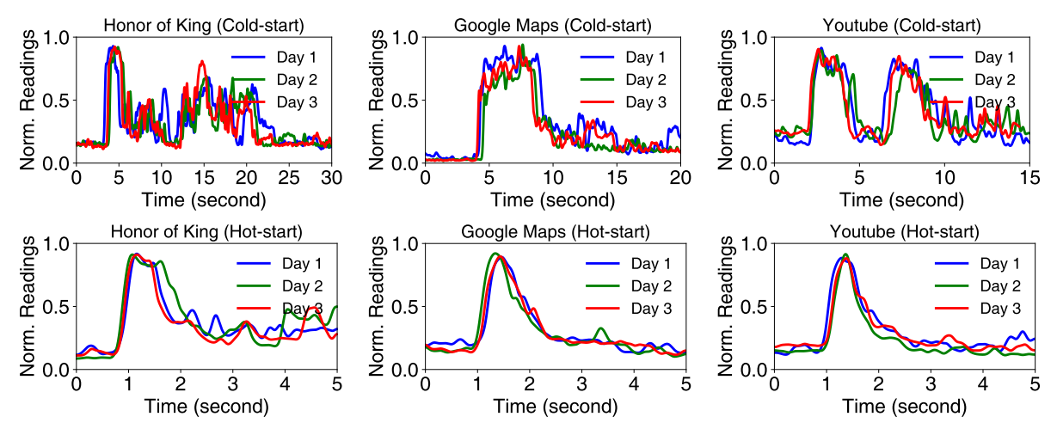
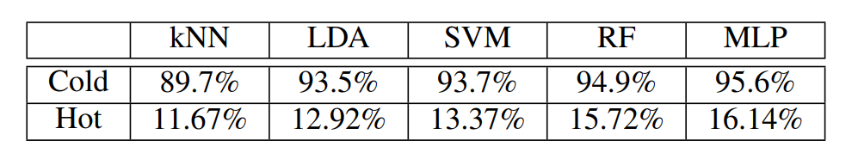
Problems of app launching identification
EM signals of app launching via Cold Start
EM signals of app launching via Cold Start
Complete app usage behaviors contains:
Start/Switch/Close timestamp
In-app service when using an app
Simultaneous usages of multiple apps
(in split-screen mode/background running)
Classification results of EM signals generated by app launching
PROBLEM 2:
App’s launching information
≠
Complete app usage behaviors
PROBLEM 1: warm start of app launching is HARD to identification.
Notes:
There are two major problems with identifying apps by their launch process. The first problem is that the EM signals generated when warmly launching different apps are relatively indistinguishable. This also leads to poor results in classifying the warm start process.
The second problem is that the app launching information does not represent the complete app usage behavior. And complete app usage behaviors should contain Start/Switch/Close timestamp of an app, in-app service information when using an app, and simultaneous usages of multiple apps.

Slide 11
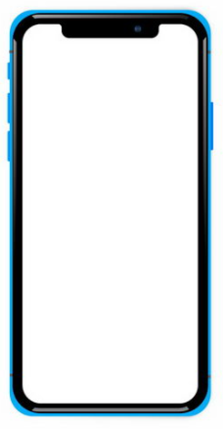








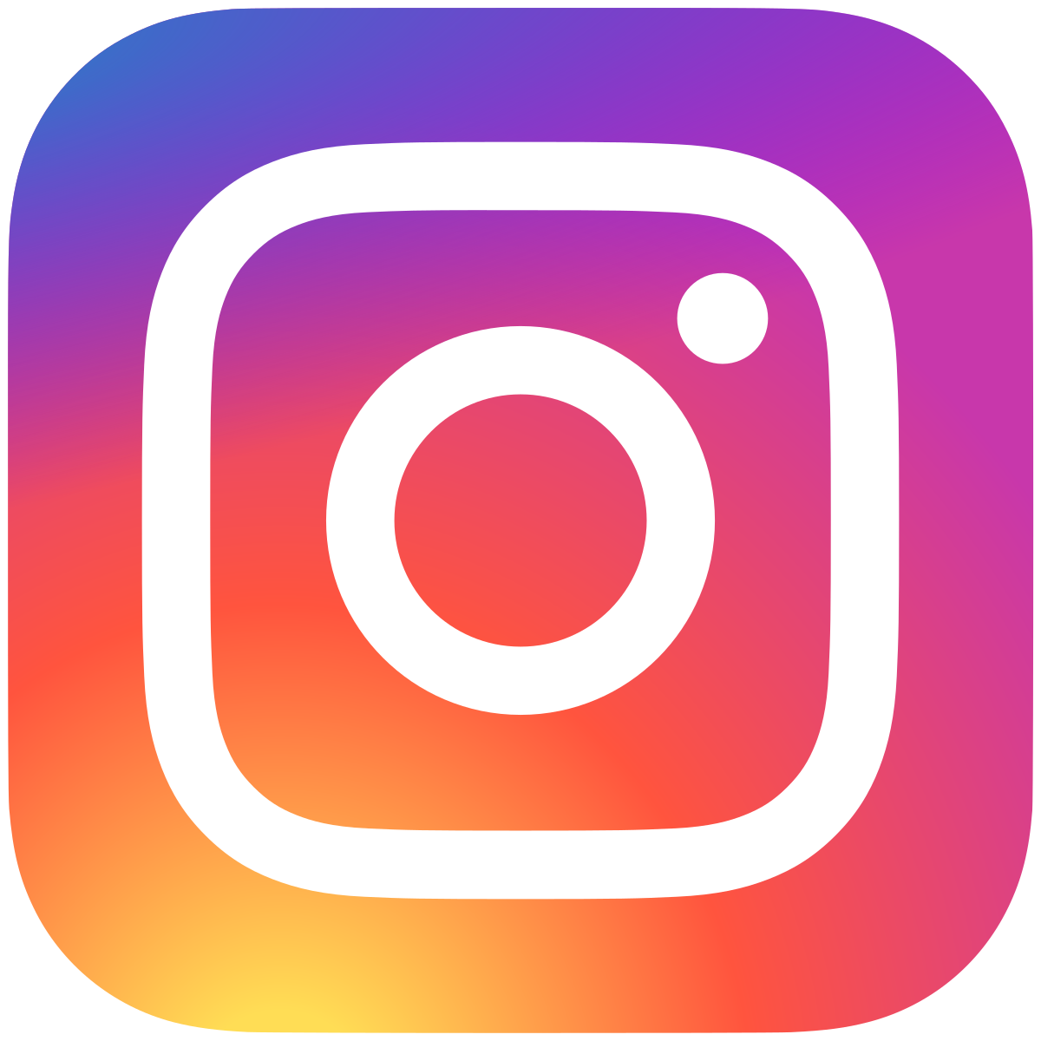


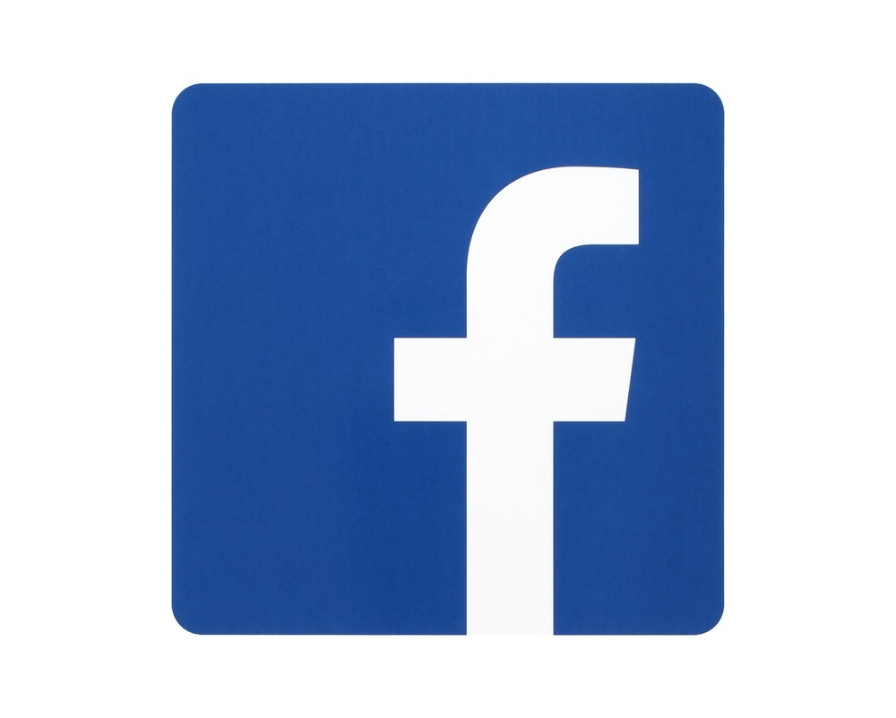


Our Target
Background
running mode
Split-screen mode
June 11, 2021
12:32
12:57
14:08
14:22
14:51
15:22
15:56
8min40sec
42min20sec
1hr5min15sec
12min30sec
18min50sec
8min50sec
Surfing
(2m10s)
Playing Game (42m20s)
Listening Music
(1h5m15s)
Video Call
(3m20s)
Watching
Video
(15m30s)
Surfing
(3m10s)
Playing
Game (22m50s)
Surfing
Websites
(22m50s)
Playing Game
(5m40s)
Text Chatting
(2m50s)
Surfing
(3m20s)
Editing Pic
(5m40s)
Text Chatting
(42m20s)
Editing Pic
(6m20s)
Tracking the complete app usage behaviors in real time :
Multi-label problem:
Identify the app & in-app services types
Multi-target problem:
Identify multiple running apps, including background running and split-screen modes
Notes:
Here, we show a complete flowchart of app usage behaviors when a user uses his smartphone over a period of time.
We found that when users use the same app, they are actually using the rich services inside the app.
And some apps support background running mode, such as Spotify, a music playing software.
Some smartphones support split-screen operation, which allows users to use more than two apps at the same moment.
Therefore, Tracking the complete app usage behaviors in real time is firstly a multi-label problem, because we should identify both the app and in-app service types. Then, it is also a multi-target problem, because we should identify multiple running apps, including background running and split-screen modes.

Slide 12
Outline
Background and Motivation
Related Works and Limitations
Preliminary Analysis
System Design
Evaluation
Conclusion
Notes:
Next we will perform some preliminary analysis to verify the feasibility of inferring complete app usage behavior through the built-in magnetic sensor readings

Slide 13


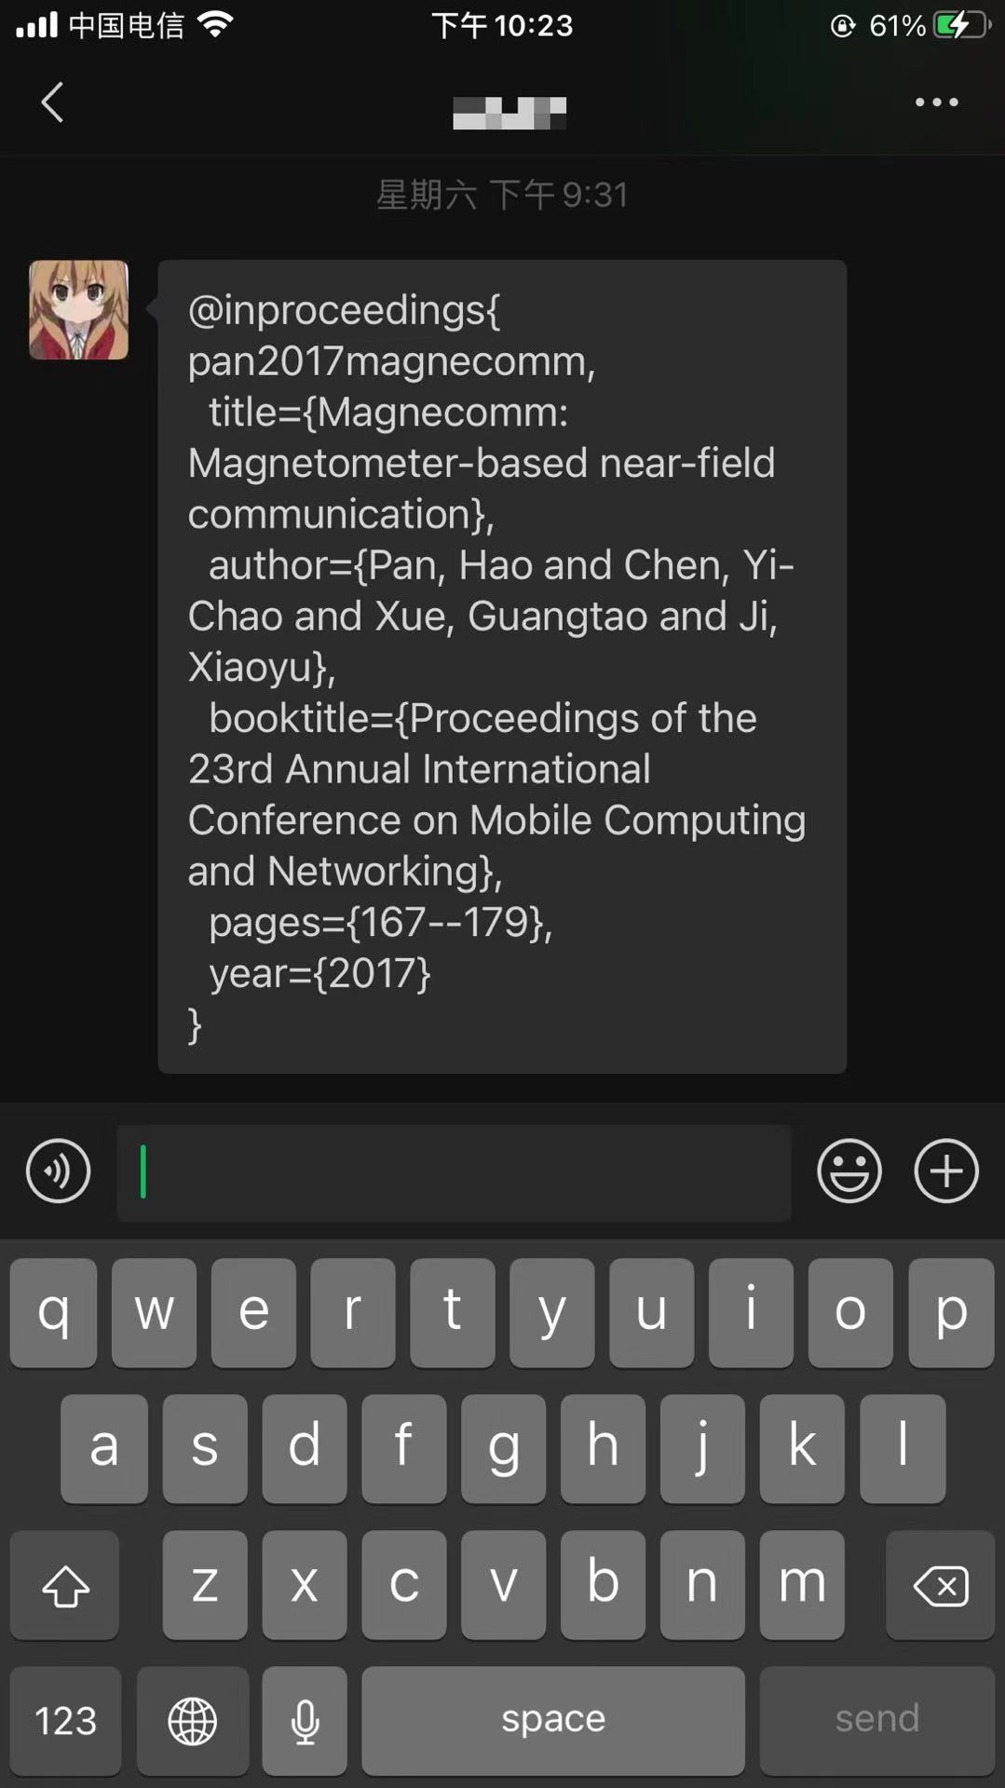
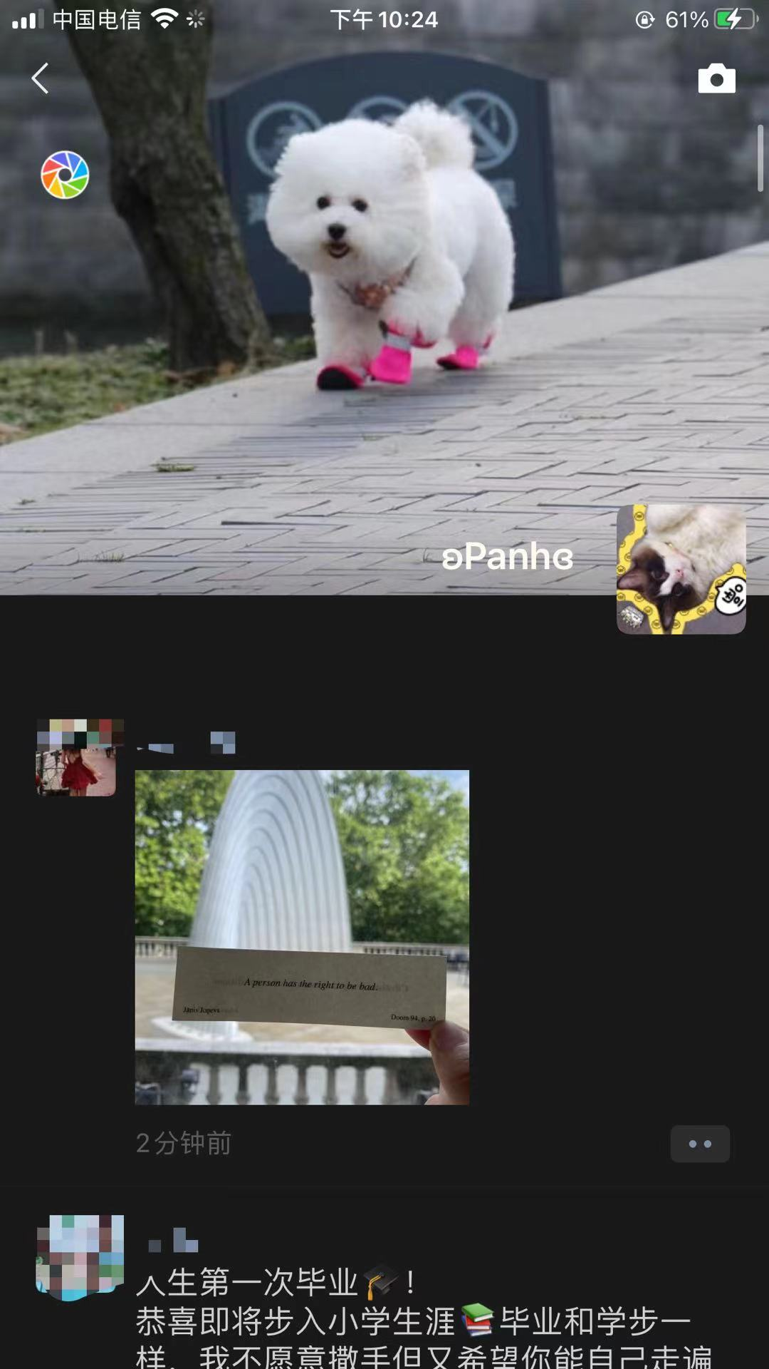
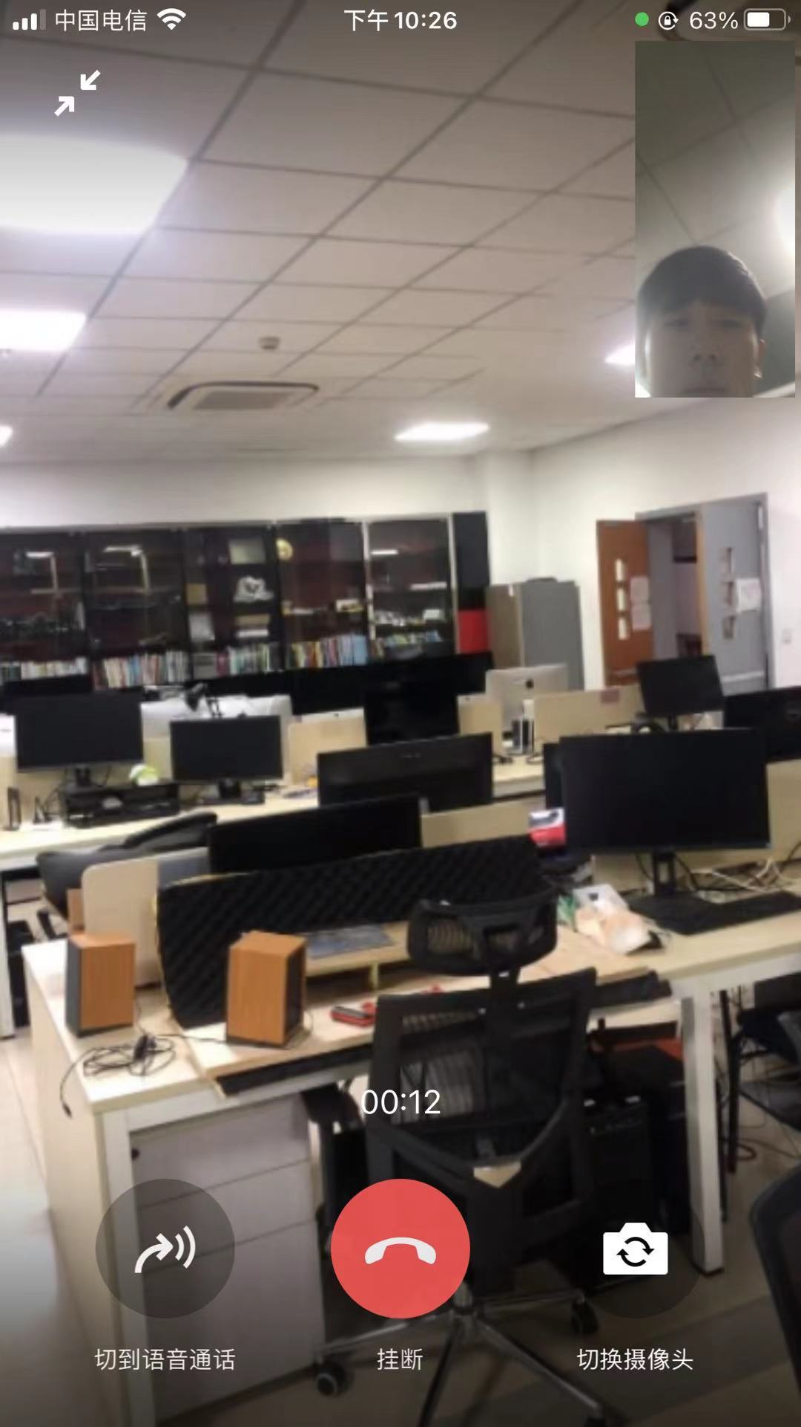
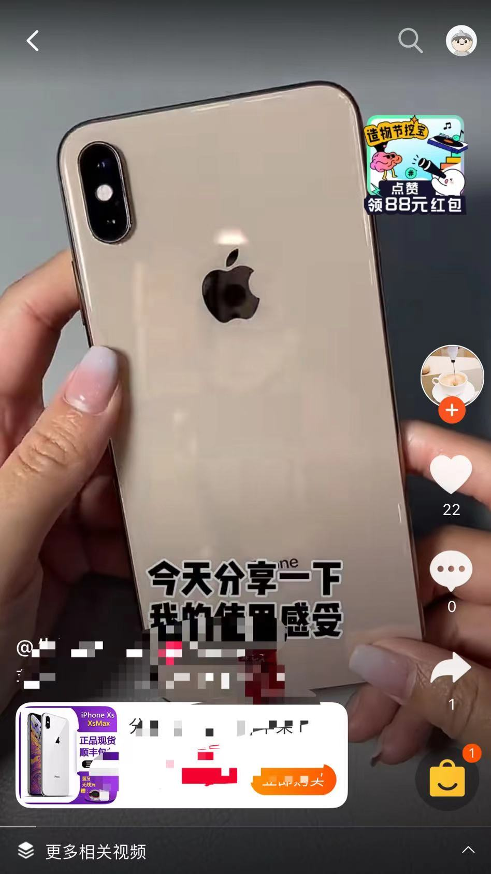
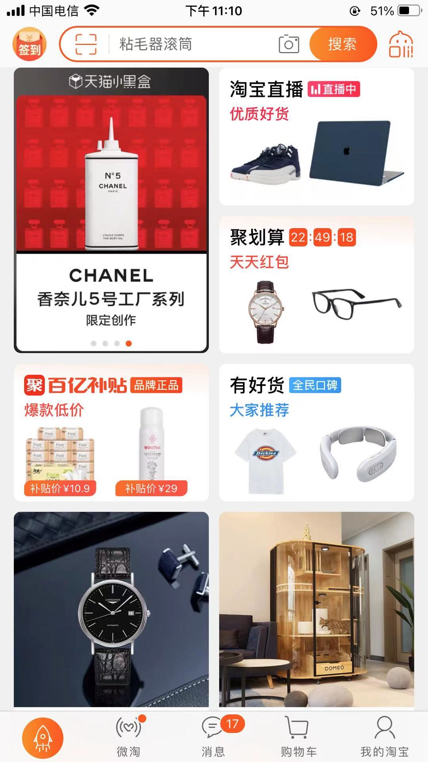

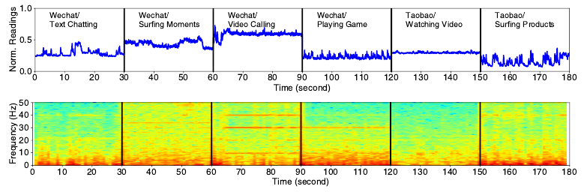
Preliminary experiment I —— app & in-app service
Text
chatting
Surfing
moments
Video
calling
Playing
games
Watching
video
Surfing
products
App 1: Wechat
App 2: Taobao
Notes:
First, we test a social type app, wechat. We use four in-app services in the wechat, they are text chatting, surfing moments, video calling, and playing games respectively.
We visualize the magnetometer readings in the both the time and frequency domain. We find that each of the four in-app services generates a unique EM signal with differentiability.
We also test a online shopping type app, Taobao. We use two in-app services: watching video and surfing products. We also find that these in-app services have different patterns of EM signals.

Slide 14


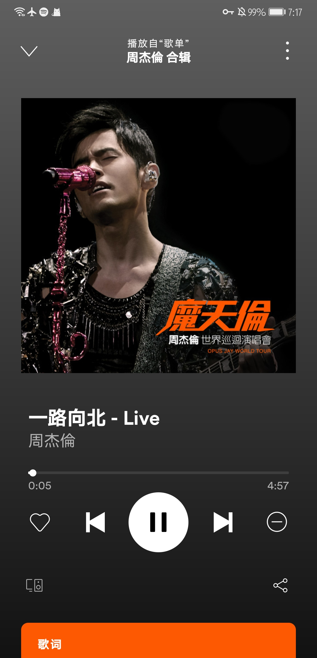
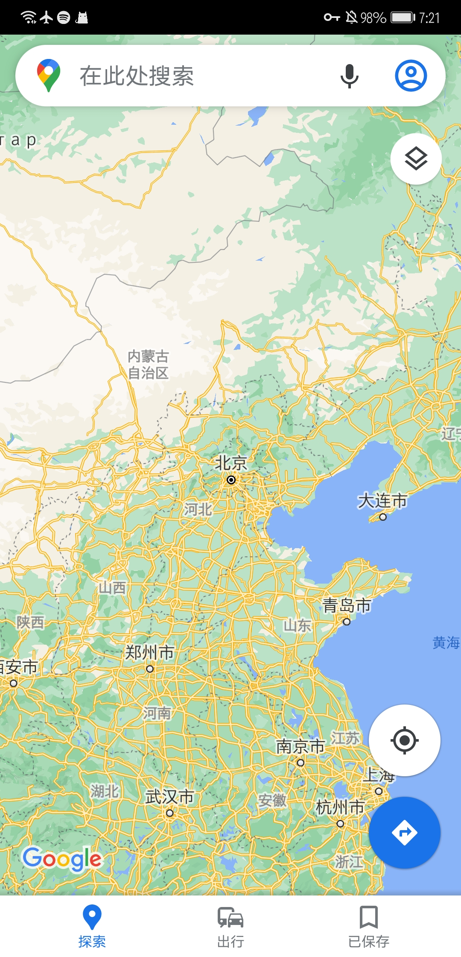
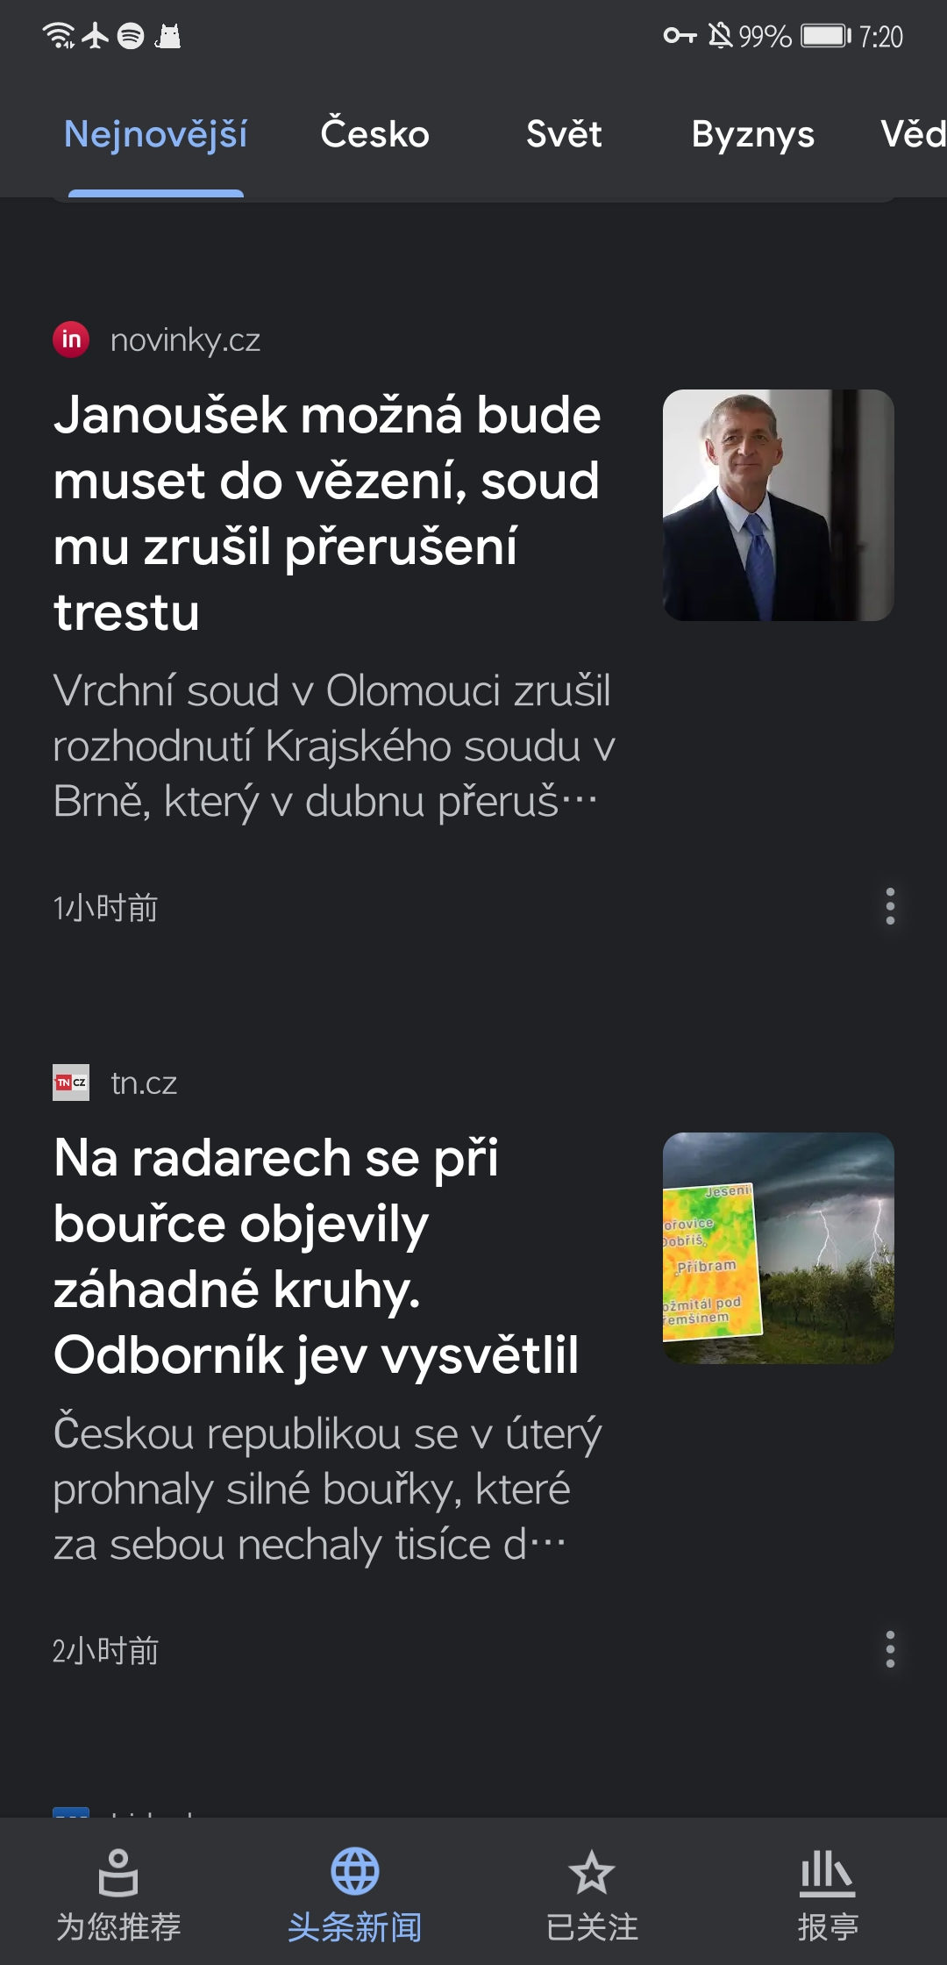
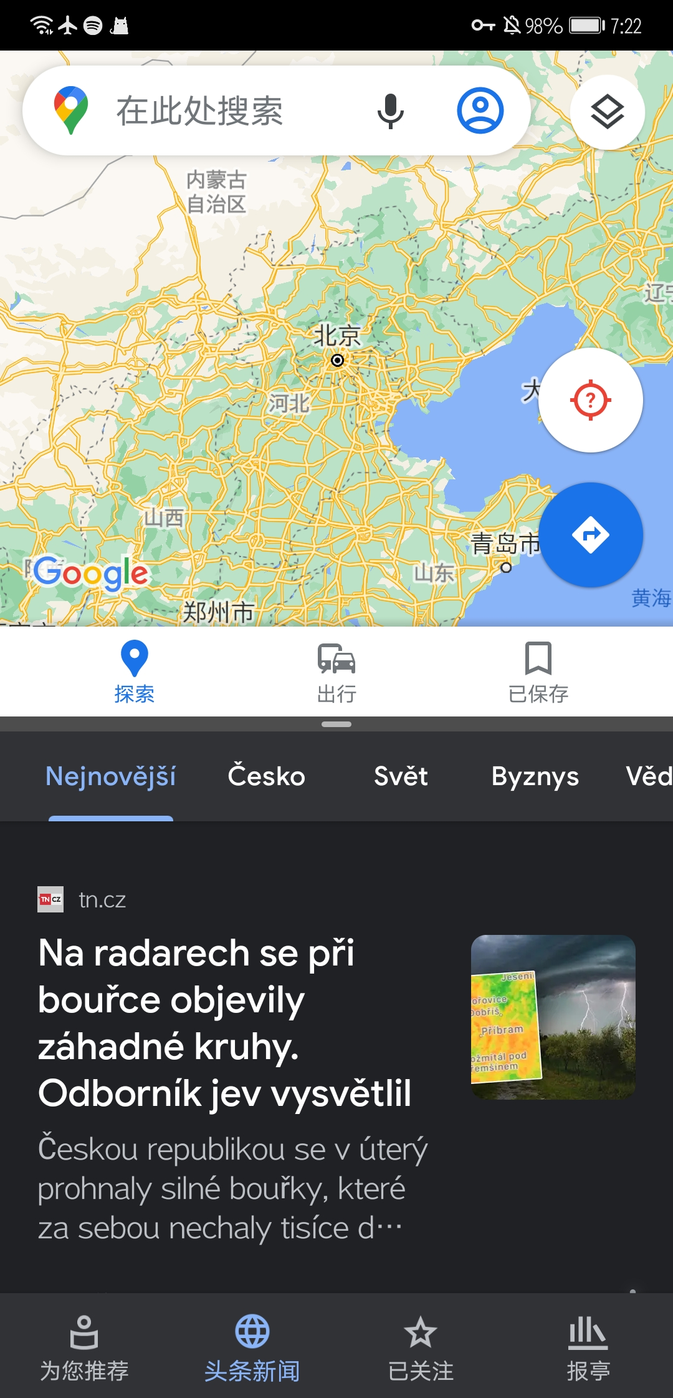
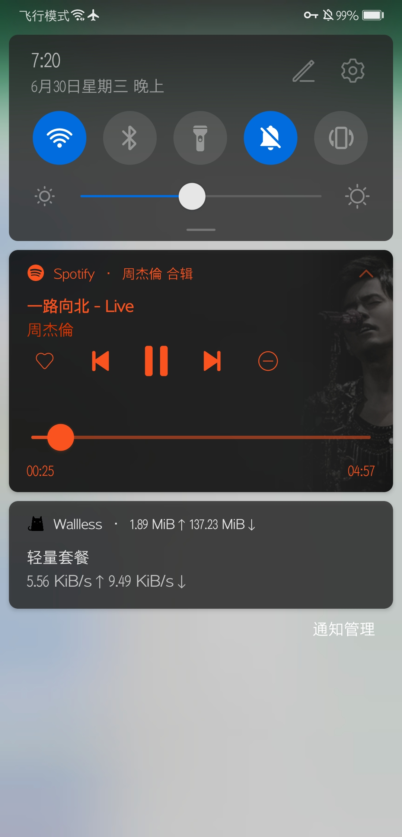
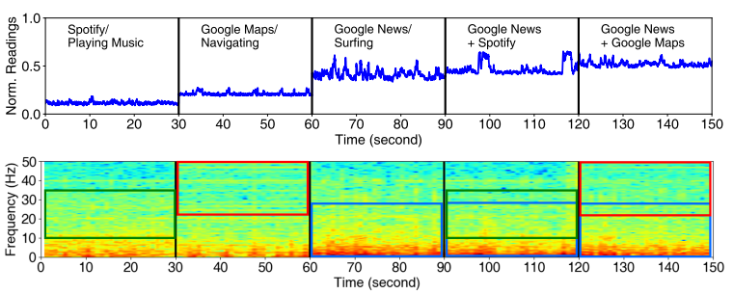
Preliminary experiment II —— multiple running apps
Spotify
Google Map
Google News
Split-screen mode
Background
running
Notes:
Next, we test the EM signal when users use multiple apps at the same time. We first run three apps individually, in turn. And corresponding EM signals in time and frequency domain are shown here. Then, we let the music player app Spotify run in the background, and run the Google News in the foreground. We also use a split-screen mode to use the Google map and Google news at the same time. The resulting EM signals show that the EM signals of running multiple apps at the same time is basically a superposition of EM signals from running each app alone.

Slide 15
Outline
Background and Motivation
Related Works and Limitations
Preliminary Analysis
System Design
Evaluation
Conclusion
Notes:
After the preliminary analysis, we will introduce the system design.

Slide 16
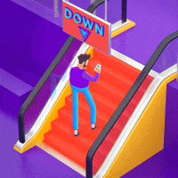
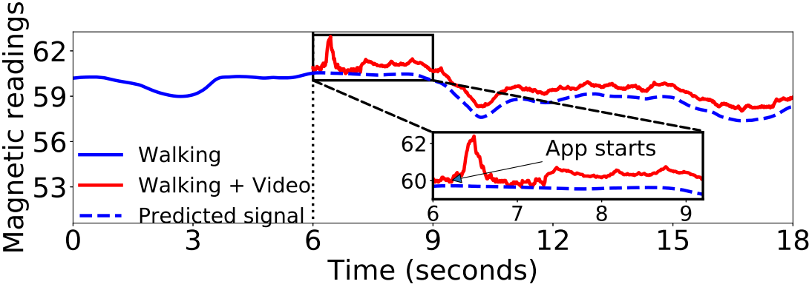
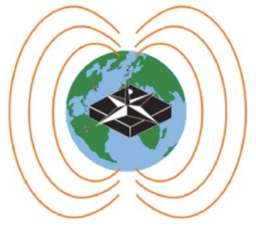
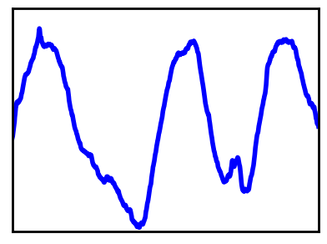
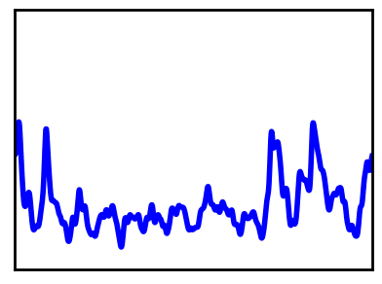


Cancel out the geomagnetic filed signals
Using phones
when walking
Raw
magnetometer
readings
STFT
Predicted
geomagnetic
fluctuation
6-axis
IMU data
“Pure” EM
signals
EM
spectrograms
Notes:
Before designing the app classification model, we first have to pre-process the data. Considering that the built-in magnetic sensor in the device will not only sense the electromagnetic radiation signal generated by the operation of the device, but also the geomagnetic signal around the device.
For example, if a person uses a smartphone while walking, the manometer readings will record all signals together. The blue line in the figure shows the changes in geomagnetic signal while walking. The red line in the figure indicates that the additional EM signals caused by watching a video on the phone.
Therefore, in the data preprocess stage, we need to cancel out this irregular and unpredictable geomagnetic signals. We utilize the 6-axis IMU data (including 3-axis accelerometer and 3-axis gyroscope) to predict the geomagnetic signals with the multi-layer perceptron model, and then obtain the Pure EM signals caused by the running apps, and used STFT to obtain the EM spectrograms.

Slide 17

Dataset collection
EM
spectrograms
Multi-label: app & in-app services
App types are known!
App1
In-app Service
labeling
How about labels of in-app services?
App2
In-app Service
Multi-target: multiple running apps
In-app service labels:
Ca: video/voice calls
Ch: text chatting/typing
ED: editing documents
LM: listening to music
EP: editing photos
PG: playing games
SU: surfing/reading
WV: watching videos
Others
EM signal clusters related to nine types of in-app services
Notes:
Here, we will describe the process of labelling our data. As mentioned above, the complete app usage behavior contains multi-label (app as well as in-app services), and multi-target (multiple running apps). During the dataset collection, we have known the app types, but there are hundreds of types of in-app services, which bring difficulties to label the in-app service labels. Therefore, we performed time-series cluster analysis on the EM data using the TSkmeans algorithm with the aim of formulating general categories pertaining to in-app services. And we obtained nine clusters, they video/voice calls, text chatting/typing, editing documents, listening to music, editing photos, playing games, surfing/reading, watching videos and Others.

Slide 18








How to define the region of each running app?
Our idea:
Region Proposal Network
Design the app/in-app classification model：
EM
spectrograms
Region of Interest (RoI)
App 1 &
in-app service 1
RoI 1
App 2 &
in-app service 2
A user uses multiple apps
simultaneously
RoI 2
Ground truth of bounding box (manual labeling)
Determine the bounding box of each single running app with STN
$w$:
Box width
$w(fixed)$:
spatial transformer network
Box width
$h$:
Box height
$h$:
$x,y$:
Box center
Box height
Notes:
How to identify multiple running apps?
Our idea is to use the region proposal network, a network structure that is particularly common in the multiple object recognition in the computer vision.
As shown in the figure, multiple pedestrians need to be identified in the figure, and the RPN will recognize each bounding box of the pedestrian, and for the recognition tasks.
Similarly, we can apply the RPN on the multi-target app usage identification problem. On each EM spectrogram, we can extract the region of interest as a bounding box, which contains the running app information. After that, we can focus on these RoIs, can recoginze the whole running apps as well as in-app services.
In the computer vision task, the ground truth of the box is usually marked manually. It is unrealistic to label these boxes manually. In our study, we fixed the box width as the while time window, thus we applied a simplified version of spatial transformer network to help us find out the suitable bounding box, to determine the box height.

Slide 19
DRCNN: multiple apps/in-app services classification
Feature maps
RoI candidates
FC Layers
FC Layers
RoI 1
Conv Layers
RPN
RoI Align Layer
RoI 2
1×1×64
Mapping
32×32×64
32×32×64
32×32×64
60×60×1
In-app service 1
App 1
In-app service 2
App 2
32×32×64
Conv Layer Structure：
Conv2D(32) – BN – ReLU – Conv2D(64) – BN – ReLU
Notes:
We proposed a Deep Region CNN called DRCNN, to identify multiple running apps/in-app services classification. And we prevent the overall architecture and pipeline of classification model here.

Slide 20
Outline
Background and Motivation
Related Works and Limitations
Preliminary Analysis
System Design
Evaluation
Conclusion
Notes:
In the experiment results,

Slide 21


Experiment Results
Determine the time interval length
of EM signals:
Multiple in-app service classification:
Average:0.946
Multiple app classification:
Average:0.883
Partly:
Social network
Notes:
In the experiment results, we use the F1 macro score as the metric to evaluate the performance of the app usage classification.
We first determine the time interval length of EM signals, from the results, we find that five seconds interval is enough for us to identify both the apps and in-app services. That means the time precision for identifying app usage is 5 seconds, which is sufficient for us to obtain detailed information.
We also show the average multiple in-app service classification and the multiple app classification here. For the in-app services, we can obtain average 0.946 F1 macro scores when classifying multiple running in-app services within nine categories. For the apps, we can obtain average 0.883 F1 macro scores when classifying multiple running apps. Note that we partly list the results of apps (in social networking category) due to the space limitation.

Slide 22




Experiment Results
Performance on different
smartphones：
Comparison of multi-label classification models
Against different environments：
For more detailed evaluation results, please read our paper ☺
Smartphone settings (e.g., battery)：
Notes:
We compare our proposed classification model with other baseline multi-label classification methods, which can be transformed into many one-versus-the-rest binary classification subtasks. The results showed the DRCNN was an outstanding classifier and could approximate the classification performance of the Multi-STN, which was
used to provide ground truth regions. It is worth mentioning that the DRCNN has a more concise and single network structure than the many binary classifiers.
We also conducted many other experiments to evaluate our system, like performance of our system when deploying on different smartphones, when users in different environments and when smartphones on different settings, please read our paper for more detailed information.

Slide 23
Outline
Background and Motivation
Related Works and Limitations
Preliminary Analysis
System Design
Evaluation
Conclusion
Notes:
In conclusion,

Slide 24
Conclusion
MagThief can steal fine-grained sensitive app usage info with the built-in magnetometer readings:
We developed a Deep Region CNN (DRCNN) to facilitate the multi-target and multi-label classification of multiple running apps as well as corresponding in-app services.
Extensive experiments demonstrated the efficacy of the MagThief, and it achieves high average macro F1 scores of 0.87/0.95 when identifying multiple apps/in-app services respectively.
Notes:
MagThief can steal fine-grained sensitive app usage information with the built-in magnetometer readings:
We developed a Deep Region CNN (DRCNN) to facilitate the multi-target and multi-label classification of multiple running apps as well as corresponding in-app services.
Extensive experiments demonstrated the efficacy of the MagThief, and it achieves high average macro F1 scores of 0.87/0.95 when identifying multiple apps/in-app services respectively.
That's all there is to our video, thanks for watching.

Slide 25
Questions
Q1: The deep learning model you proposed in your paper need to be trained for each unseen device? In other words, how about the performance against untrained devices?
Thanks for your good question. In fact, there are thousands of mobile phones from different manufacturers on the market, some smartphone manufacturers optimize the app starting process, to let users have a better experience, such as pre-loading/pre-launching the app to short the time of cold starting. So identifying the apps with the launching process should consider the differences of EMI patterns from different smartphones.
However, our work is to identify the EMI signal generated when using the app. When different smartphones perform the same tasks in the same app, the codes they execute are always the same. We consider the two mainstream mobile operating systems, Android and iOS. We trained a classification model for Android phones and another classification model for iPhones. And the Operating System Type information is very easy to obtain. In this way, we can deploy our model on unknown devices, with the operating system type of the target device.

Slide 26
Questions
Q2: There are thousands of apps on the market, and your model seems to be able to recognize only a limited number of apps in the training data set. How to identify those apps that are not in the data set?
Yeah, thanks for your good question. Our proposed model is a supervised learning method, so we indeed need to collect electromagnetic radiation signals when users use various types of apps in advance, and collect this data as training dataset. In this work, we collected the mainstream apps, the top 50 most popular apps from the Google play and Apple store, as our training dataset. So our model currently supports the identification of these 50 mainstream apps.
We also design our model as a multi-label classification model (to identify the running apps and corresponding in-app services), and we defined the limited categories of in-app services, so when we face untrained apps, we can still identify the current using in-app service information from users. In the future work, we will hire more volunteers to collect EMI training dataset of more apps, so that our model supports the identification of more apps.

Slide 27
Questions
Q3: How spatial transform network works? And why Region Proposal Network can find out the multiple running apps?
Spatial transform network can help us find the sub frequency band that is most conducive to identifying the current running app/in-app service from the entire EM spectrogram. Similar to the object detection problem in computer vision, for example, there is a cat in an image, but this cat only occupies a small area in the entire image, so STN can be used to find the smallest area that contains the cat, in this way we can focus on this small area instead of the entire image to identify objects.
When we use STN to find out the bounding box of each running app or in-app service in the EM spectrogram. We can train an Region Proposal Network. This Region Proposal Network is used to find the whole sub frequency bands that most likely to contain the running app or in-app service. If multiple boxes are found, it means that the current device is running multiple apps. In this way, we can realize the multi-target classification.

